Slide 1
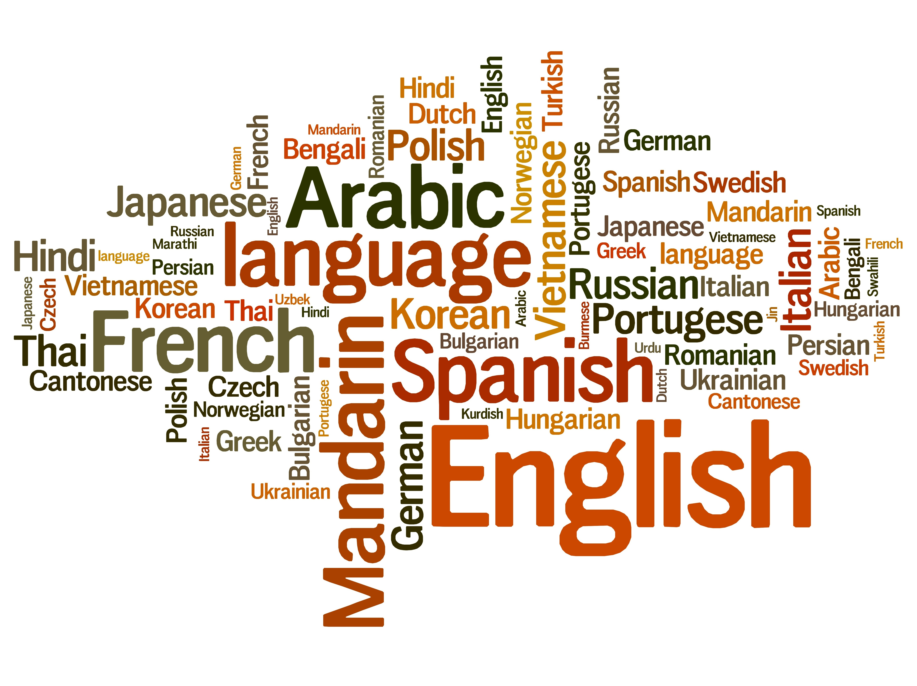
Dive Deeper into Present-Day English
Vol.3 -English Vocabulary 1(Compounds・Derivatives・Load Words)-
Composed By: Hayato Ishida
For Japanese version, click here
Updated On: 16 July 2024

Slide 2
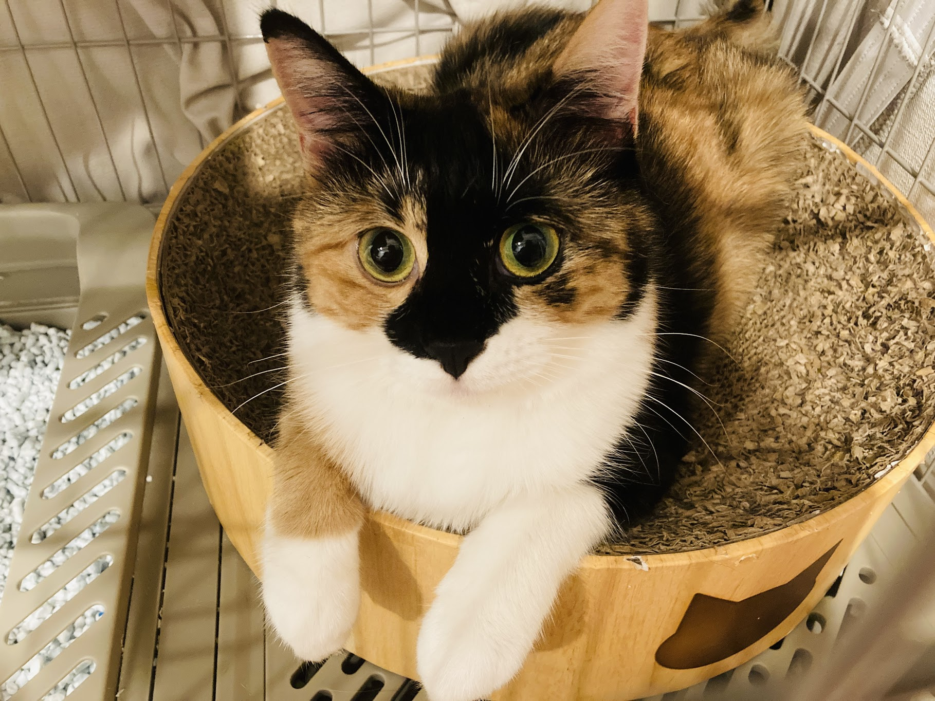
About Me
Accounts
GitHub: @hayat01sh1da
X: @hayat01sh1da
LinkedIn: @hayat01sh1da
Speaker Deck: @hayat01sh1da
Docswell: @hayat01sh1da
Occupation: Software Engineer
Things I Am Into
Linguistics
Singing at Karaoke
Listening to Music
Watching Movies
Cat Feeding

Slide 3
Licences / Certifications
English
TOEIC® Listening & Reading 915: Certified on December 2019
Engineering
Information Security Management: Certified on November 2017
Applied Information Technology Engineer: Certified on June 2017
Fundamental Information Technology Engineer: Certified on November 2016
IT Passport: Certified on April 2016
Others
Abacus 2nd Class: Certified on June 2002
Mental Arithmetic 3rd Class: Certified on February 2001

Slide 4
Skill Stack
Languages
Japanese: Native Proficiency
English: Full professional Proficiency
Development
Backend: Ruby(Ruby on Rails), Python
Frontend: TypeScript + React.js, TypeScript +Vue.js
Database: MySQL, PostgreSQL, MongoDB
Architecture: Monolith, Modular Monolith
Hosting: AWS ESK
Versioning: Git, GitHub
CI/CD: GitHub Actions, ArgoCD
Monitoring: Datadog, Sentry

Slide 5
Work Histories
Period | Genre | Position | Jobs
Aug 2021 - Present | Saas(Educational Service) | Software Engineer | Backend Development Frontend Development CI/CD Maintenance Weekly Release Manager Troubleshooting Documentation Technical Debt Resolution Tech Blog Entries LT Speaker
Feb 2020 - Dec 2020 | SaaS(Chatbot Platform) | Backend Engineer | Backend Development Documentation Technical Debt Resolution Inspection of Alternative API

Slide 6
Work Histories
Period | Genre | Position | Jobs
Jun 2018 - Jan 2020 | Contract-basis Developer | Software Engineer | Backend Development Frontend Development Troubleshooting Quality Assurance Tech Blog Entries
Apr 2016 - Jan 2018 | System Engineering Service | System Engineer | Corporate Account Admin Windows Server Maintenance Security Admin Assistant Internationalisation / Localisation

Slide 7
International-Exchange Activities
Activities in University
English Linguistics Seminar(Focusing on Mass Media English)
International-Exchange Clubs(The 2nd Year)
International-Exchange Programmes conducted by Japan Cabinet Office(2013 - 2016)
Japanese Linguistics Course(The Final Year)
Overseas Life Experience
Working Holiday in Australia(April 2014 - March 2015)
Language School for 1 month in Sydney
Work for 6 Months in Hamilton Island Resort
Volunteering for 1 Month as Assistant Teacher of Japanese Language at St Ives High School in NSW
Other Activities
Keep Everyday Journal in English (April 2014 - Present)
Sunrise Toastmasters Club(February 2017 - March 2018)
Vital Japan(January 2018 - July 2019, October 2022 - February 2023)
Self Learning and Training of English Language
Participation Ruby-Related Tech Conferences

Slide 8
Goals of This Series
To know how deep English Language is
Not simply a communication tool
To know your own language by knowing another
"He who knows no foreign languages knows nothing of his own." by Johann Wolfgang von Goethe
To pursue the essence that does not instantly but work later on
Something which you think is meaningless has something genuine

Slide 9
Agenda
Compounds
Derivatives
Loan Words
Summary
References

Slide 10
1. Compounds

Slide 11
1. Compounds
Vocabulary coined by combination of more than existing 2 words are called
Compounds.
This method has been disappearing in Present-Day English, but it used to be traditionally adapted in Germanic language such as English, German and Dutch.

Slide 12
1. Compounds
Examples of Nouns
Compounds | Words 1 | Words 2 | Meanings
yellow jacket | yellow | jacket | hornet
redneck | red | neck | an uneducated white farm labourer, especially from the South a bigot or reactionary, especially from the rural working class
butterfingers | butter | fingers | a clumsy person
greenhouse | green | house | a building, room, or area, usually chiefly of glass, in which the temperature is maintained within a desired range
airport | air | port | a tract of land or water with facilities for the landing, takeoff, shelter, supply, and repair of aircraft
warehouse | ware | house | a building, or a part of one, for the storage of goods, merchandise, etc. [British] a large retail store

Slide 13
1. Compounds
Examples of Adjectives
Compounds | Words 1 | Words 2 | Meanings
easygoing | easy | going | calm and unworried; relaxed and rather casual
eye-catching | eye | catching | tending to attract attention; striking
diehard | die | hard | someone who opposes change and refuses to accept new ideas
old-fashioned | old | fashioned | not considered to be modern or fashionable anymore
self-employed | self | employed | earning one's living directly from one's own profession or business, as a freelance writer or artist, rather than as an employee earning salary or commission from another
open-minded | open | minded | having or showing a mind receptive to new ideas or arguments unprejudiced; unbigoted; impartial

Slide 14
1. Compounds
Examples of Verbs
Compounds | Words 1 | Words 2 | Meanings
underestimate | under | estimate | to estimate at too low a value, rate, or the like
handwash | hand | wash | to launder by hand rather than by washing machine
sweet talk | sweet | talk | [informal] cajolery; soft soap
spoon-feed | spoon | feed | to cause to be spoon-fed

Slide 15
2. Derivatives

Slide 16
2. Derivatives
Vocabulary coined by adding an affix to existing words and converting their word classes are called derivatives.
Affixes are divided into prefix and suffix.

Slide 17
2. Derivatives
Examples of Prefixes
Derivatives | Prefixes | Meanings of Prefixes
antivirus | anti- | against, opposite of, antiparticle of
exceed | ex- | out of, from, utterly, thoroughly, not, without
incomplete | in- | a negative or privative force
unhappy | un- | not
prepare | pre- | prior to, in advance of, early, beforehand, before, in front of
reply | re- | again, again and again, back, backward
despair | de- | privation, removal, separation, negation, descent, reversal, intensity
misunderstand | mis- | ill, mistaken, wrong, wrongly, incorrectly

Slide 18
2. Derivatives
Examples of Suffixes
Derivatives | Suffixes | Meanings of Suffixes | Class Conversions
washable | -able | capable of, susceptible of, fit for, tending to, given to | Verb → Adjective
protection | -ion | the act, state, or result of doing something | Verb → Noun
singer | -er | forms the comparative of many short adjectives and adverbs | Verb → Noun
impressive | -ive | someone or something that does something or can do something | Verb → Adjective
beautiful | -ful | full of something | Noun → Adjective
hopeless | -less | without something | Adjective → Adverb
slowly | -ly | in a particular way | Adjective → Adverb
happiness | -ness | forms nouns from adjectives | Adjective → Noun

Slide 19
3. Loan Words

Slide 20
3. Loan Words
English has absorbed a wide range of vocabulary from various languages through the following historical and literary backgrounds.
Invasion by Another Ethnic Group(e.g., Norman Conquest: Language conflict with French)
Books(Contact with Latin)
Contact Other Languages via Trades and Diplomacies
Easier Access to Other Languages thanks to Development of Civilisation
Vocabulary imported from other languages the backgrounds above is called Loan Words or Borrowings.

Slide 21
3. Loan Words
Loan Words from Latin
Covers technical terms related to science, technology, religion and literature
minister
priest
clerk
consecrate
anthem
fact
fragile
separate
estimate
chest
spend

Slide 22
3. Loan Words
Loan Words from French
Covers a wide range of words such as daily terms to technical ones
country
fruit
poor
peace
nice
safe
dress

Slide 23
3. Loan Words
Loan Words from Scandinavian
Covers basic words English consists of
they - their - them
law
take
get
sky
window
die
call
cast
want

Slide 24
3. Loan Words
Load Words from Other Languages
Loan Words | Origins
yacht | Dutch
melon | Greek
tea | Chinese
orange | Arabic
cigarette | Spanish
hara-kiri | Japanese

Slide 25
4. Summary

Slide 26
4. Summary
Compounds: Vocabulary coined by combination of more than existing 2 words.
Derivatives: Vocabulary coined by adding an affix to and existing words and converting their word classes.
Loan Words: Vocabulary imported from other languages the historical and literary backgrounds.

Slide 27
5. References

Slide 28
5. References
Kiyoaki Kikuchi・Kazutomo Karasawa ・Takeshi Koike・ Ryuichi Hotta ・Kazuki Fukuda・ Yasuyuki Kaizuka ・Takeshi Matsuzaki, 英語学：現代英語をより深く知る ために-現代英語の諸相と英語学術語解説-, Osaka, 浪漫書房, 2008
Dictionary.com
Last Accessed On: 03 February 2024
Longman Dictionary of Contemporary English
Last Accessed On: 03 February 2024

Slide 29
EOD

